Slide 1

Implementation of Automatic system to reduce bandwidth usage in real time video network
Under the Guidance of : -
Dr. UMAKANT P KULKARNI
BATCH NUMBER – B21
Team Members: -
2SD18CS015 – ANANTH DAYAKAR HEGDE 2SD18CS016 – ANKIT ANAND 2SD18CS130 – S VARUN 2SD18CS059 – MOHAMMED USMAN E GANI

Slide 2
Contents
Problem Statement
Introduction
Literature Survey
Objectives
Detailed Design
Project Specific Requirement
Implementation
First Phase Completion

Slide 3
PROBLEM STATEMENT
Implementation of automotive system reduce bandwidth usage in real time video system
With the advancement in technology, there comes a rise in the amount of network traffic. This may cause different types of issues like server delays, lags which can hinder user experience. Even though, the user owns a high-speed internet network, he/she might not be able to receive the expected output.

Slide 4
INTRODUCTION
The project’s main aim is to reduce network traffic when using real time video services such as video conferencing or surveillance.
The project contains 2 main components, mainly, the multi client connection module and frame differentiation and reconstruction module.
Both are integrated into the final software, and a significant loss of data required is noticed upon doing this.

Slide 5
LITERATURE SURVEY
Due to rise in technology, there are new challenges faced by the existing transmission systems such as: -
1. Streaming all data is impractical due to severe energy and bandwidth constraints.
2. Processing cost is significantly lower than communication cost.
3. It makes sense to reduce size of data before sending.
4. Visual data processing is computationally expensive.
5. It is challenging to design interaction and communication protocol.
6. Reliability of sending data is crucial.

Slide 6
Objectives
To Understand the technologies to be used in the implementation of the project.
Design of test bed (Virtual sandbox for experimentation) and optimization of the algorithm.
Development of test bed, where the test bed is supposed to show all the clients that are currently connected to the particular room, while also providing basic metrics like latency, frame per sec, bandwidth saved.
Development of image differentiating and reconstruction suites.
On the server, the differentiating engine acts as a pre-processor, comparing the previous frame to the current frame and sending the differences and reconstructs the video. On the client side, the frame is then reconstructed based on the data received.
Integration of above-mentioned backend and the frontend.

Slide 7
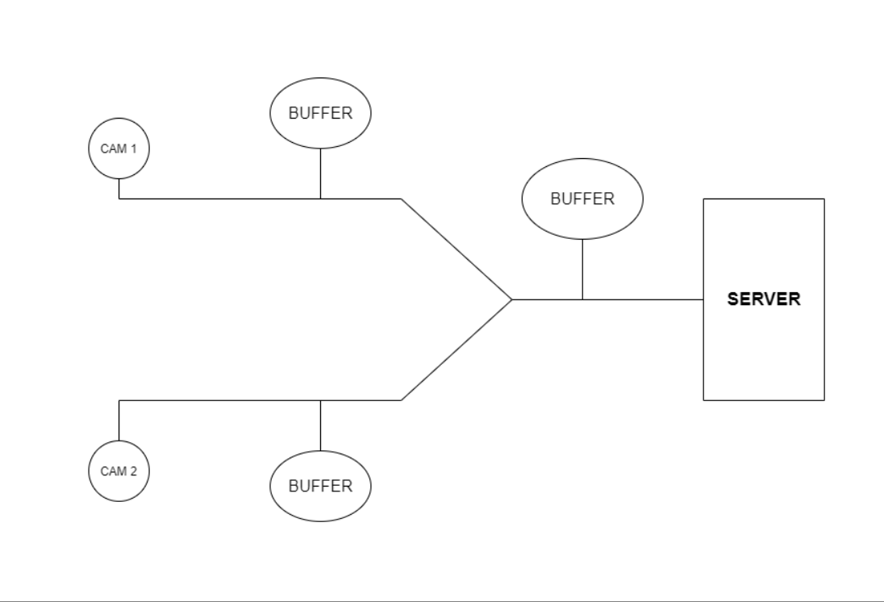
DETAILED DESIGN

Slide 8
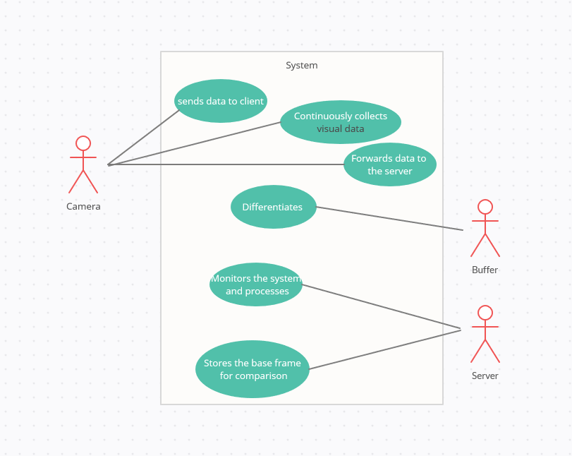

Slide 9
PROJECT SPECIFIC REQUIREMENTS
1.NodeJS, to conduct real time video and audio transmission.
2. JavaScript, HTML and CSS for front end entity management.
3. ReactJS as the state management JavaScript framework.
4. OpenCV (JavaScript) for image recognition, differentiation and reconstruction

Slide 10
IMPLEMENTATION

Slide 11
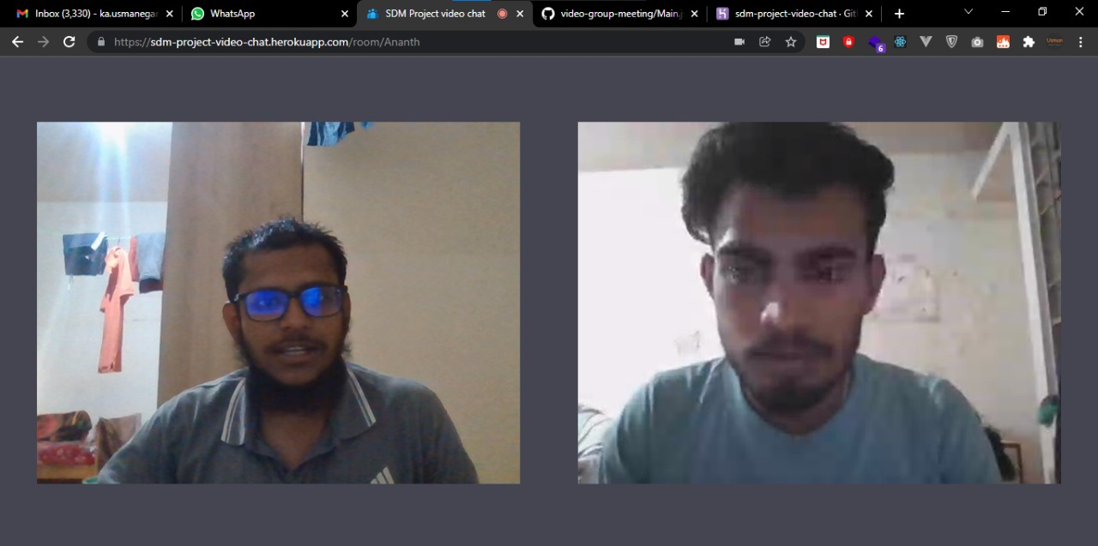
Two Clients

Slide 12
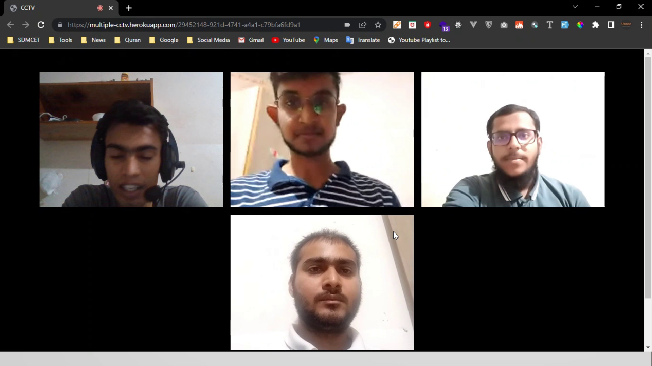
Multi Client

Slide 13
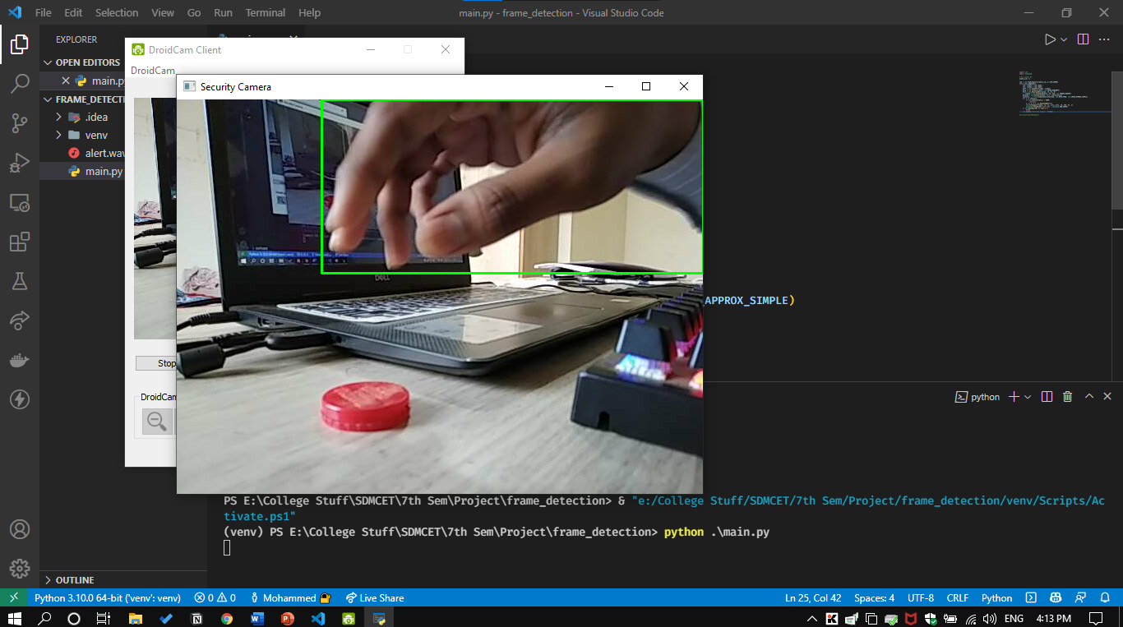
Frame Detection

Slide 14
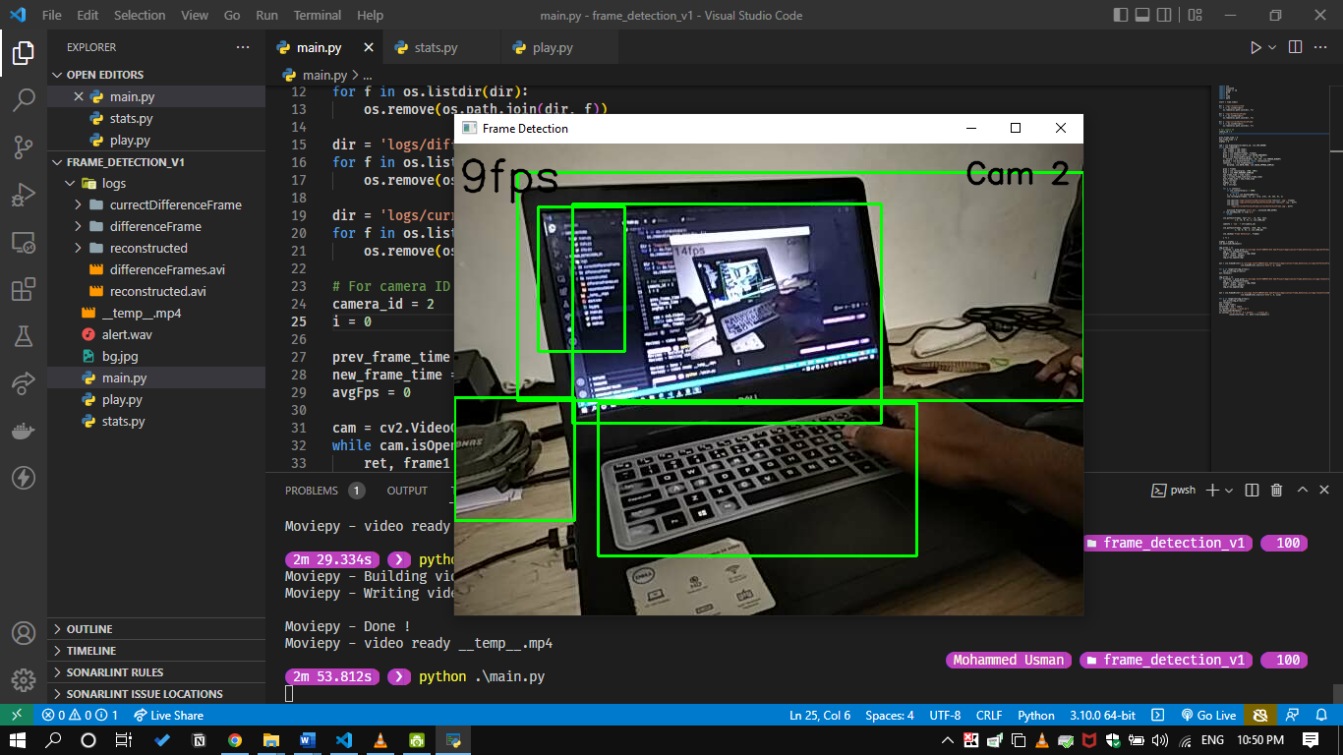
Frame Detection

Slide 15
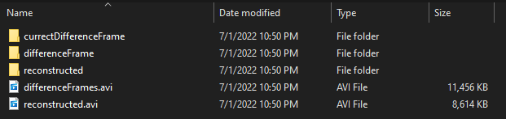
Logs

Slide 16
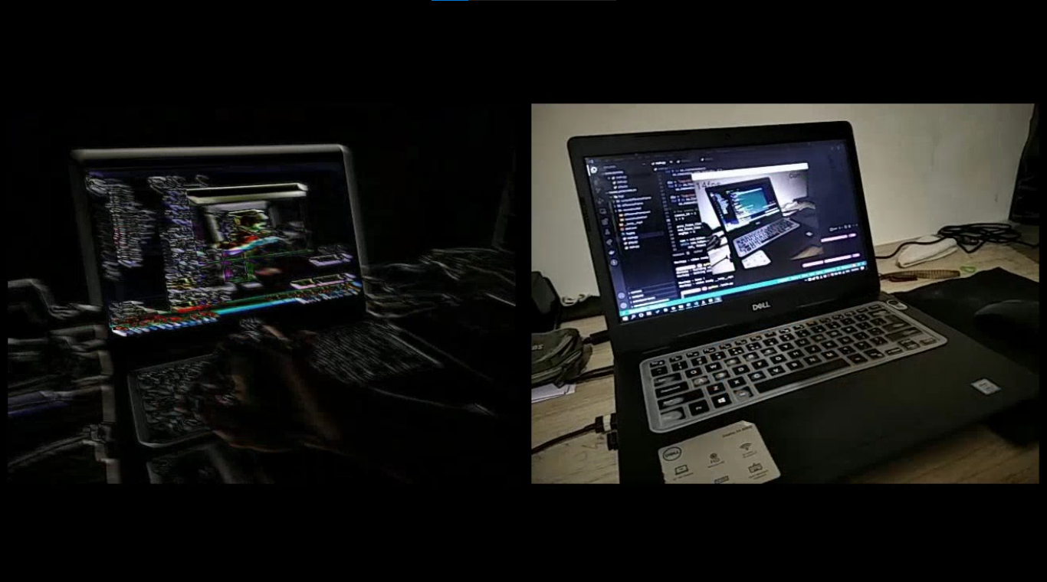
Comparison

Slide 17
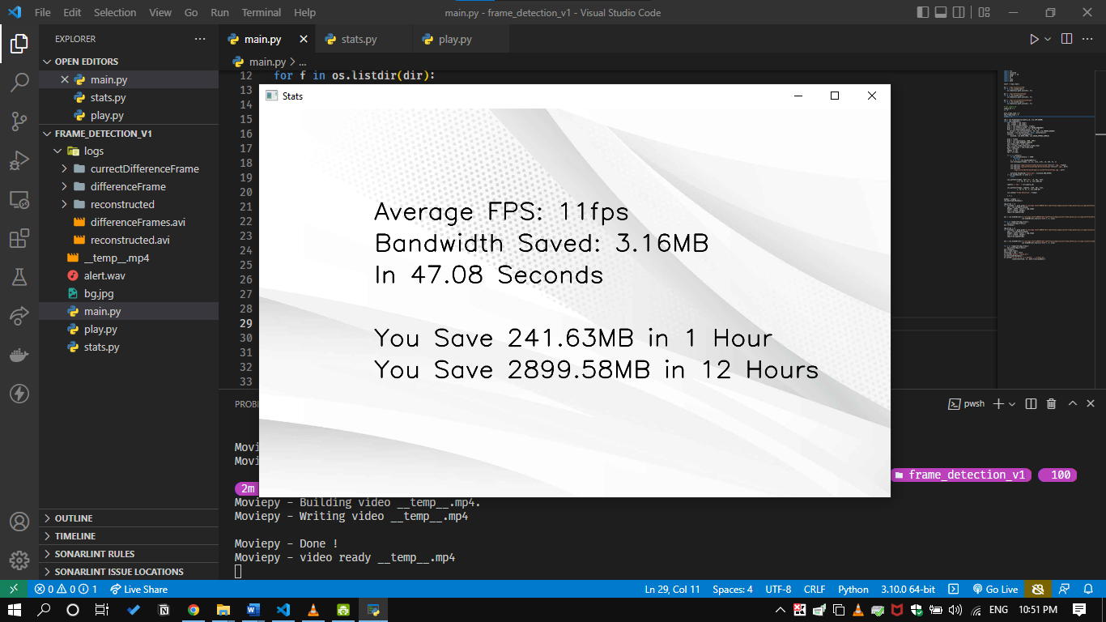
Statistics

Slide 18
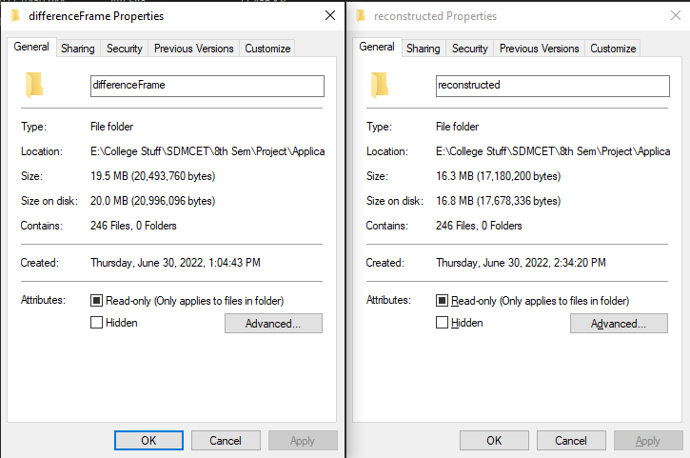
Proof

Slide 19
THANKYOU
Under the Guidance of : -
Dr. UMAKANT P KULKARNI
BATCH NUMBER – B21
Team Members: -
2SD18CS015 – ANANTH DAYAKAR HEGDE 2SD18CS016 – ANKIT ANAND 2SD18CS130 – S VARUN 2SD18CS059 – MOHAMMED USMAN E GANI

